Slide 1
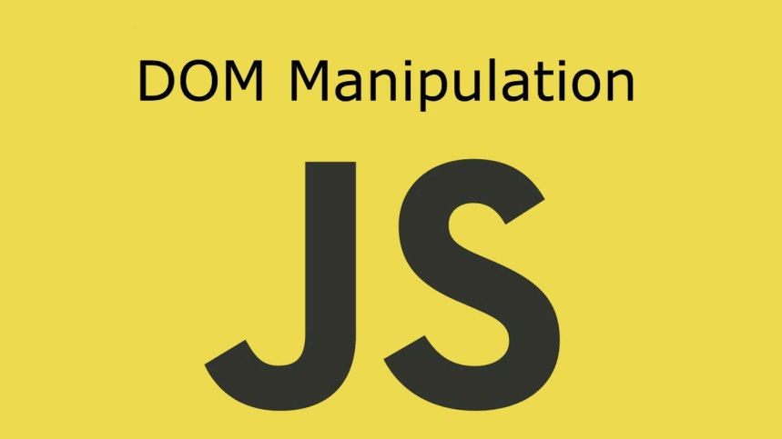
DOM Manipulations
Create / Delete DOM Elements, Handle Browser Events
SoftUni Team
Technical Trainers
Software University
https://softuni.bg

Slide 2
Table of Contents
Callback
Event Loop
Event Types
Event Object Properties and Methods
Handling Events

Slide 3
Have a Question?
sli.do #js-front-end

Slide 4
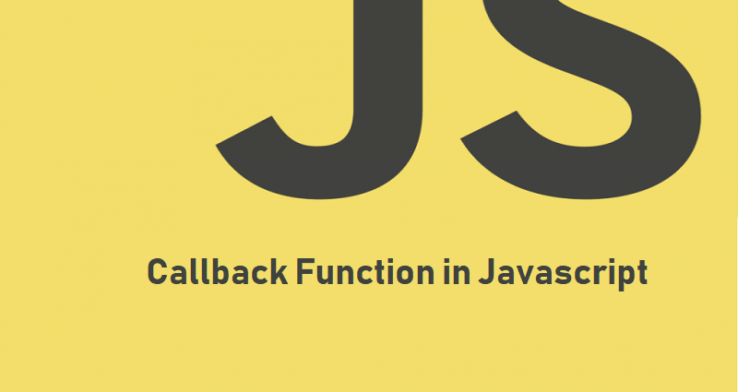
Callback

Slide 5
What is callback?
A function passed into another function as an argument
Invoked inside the outer function to complete some kind of routine or action
let add = function(a, b) {
return a + b;
};
let calc = function(num1, num2, callback) {
return callback(num1, num2);
};
console.log(calc(1, 2, add));

Slide 6

Event Loop
Stack Calls

Slide 7
JS Approach to I/O
Single threaded language
HTTP requests
DB
Memory and disk read/write

Slide 8
Stack Calls
function foo(x) {
return x * x;
}
function bar(y) {
return foo(y + 2);
}
bar(8);
Stack

Slide 9
Stack Calls
function foo(x) {
return x * x;
}
function bar(y) {
return foo(y + 2);
}
bar(8);
Stack
bar(8)

Slide 10
Stack Calls
function foo(x) {
return x * x;
}
function bar(y) {
return foo(y + 2);
}
bar(8);
Stack
foo(10)
bar(8)

Slide 11
Stack Calls
function foo(x) {
return x * x;
}
function bar(y) {
return foo(y + 2);
}
bar(8);
Stack
return
bar(8)

Slide 12
Stack Calls
function foo(x) {
return x * x;
}
function bar(y) {
return foo(y + 2);
}
bar(8);
Stack
bar(8)

Slide 13
Stack Calls
function foo(x) {
return x * x;
}
function bar(y) {
return foo(y + 2);
}
bar(8);
Stack
return

Slide 14
Stack Calls
function foo(x) {
return x * x;
}
function bar(y) {
return foo(y + 2);
}
bar(8);
GC

Slide 15
Stack Calls
function foo(x) {
return x * x;
}
function bar(y) {
return foo(y + 2);
}
bar(8);
Stack

Slide 16
How It's Handled in JS?
Message queue
Event loop
function init(el){
el.addEventListener("click", handler);
}

Slide 17
Stack Calls
Stack
Browser APIs
Hidden implementation

Slide 18
Stack Calls
Stack
Browser APIs
Hidden implementation
init

Slide 19
Stack Calls
Stack
Browser APIs
Hidden implementation
addEventListener
init

Slide 20
Stack Calls
Stack
Browser APIs
Hidden implementation
addEventListener
init
Event Callback

Slide 21
Stack Calls
Stack
Browser APIs
Hidden implementation
return
init
Event Callback

Slide 22
Stack Calls
Stack
Browser APIs
Hidden implementation
return
Event Callback

Slide 23
Stack Calls
Stack
Browser APIs
Hidden implementation
GC
Event Callback

Slide 24
Stack Calls
Stack
Browser APIs
Hidden implementation
Event Callback

Slide 25
Stack Calls
Stack
Browser APIs
Hidden implementation
Message Queue
….
Event Callback

Slide 26
Stack Calls
Stack
Event Loop
Browser APIs
Hidden implementation
Message Queue
….
Event Callback

Slide 27
Stack Calls
Stack
Event Loop
Browser APIs
Hidden implementation
Message Queue
H
….
Event Callback

Slide 28
Stack Calls
Stack
Event Loop
Browser APIs
Hidden implementation
Message Queue
H
H
Event Callback

Slide 29
Stack Calls
Stack
Event Loop
Browser APIs
Hidden implementation
Message Queue
H
H
Event Callback

Slide 30
Stack Calls
Stack
Event Loop
Browser APIs
Hidden implementation
Message Queue
H
H
handler
Event Callback

Slide 31
Stack Calls
Stack
Event Loop
Browser APIs
Hidden implementation
Message Queue
H
handler
Event Callback

Slide 32
Stack Calls
Stack
Event Loop
Browser APIs
Hidden implementation
Message Queue
H
return
Event Callback

Slide 33
Stack Calls
Stack
Event Loop
Browser APIs
Hidden implementation
GC
Message Queue
H
Event Callback

Slide 34
Stack Calls
Stack
Event Loop
Browser APIs
Hidden implementation
Message Queue
H
Event Callback

Slide 35
Stack Calls
Stack
Event Loop
Browser APIs
Hidden implementation
Message Queue
H
handler
Event Callback

Slide 36
Stack Calls
Stack
Event Loop
Browser APIs
Hidden implementation
Message Queue
handler
Event Callback

Slide 37
Stack Calls
Stack
Event Loop
Browser APIs
Hidden implementation
Message Queue
return
Event Callback

Slide 38
Stack Calls
Stack
Event Loop
Browser APIs
Hidden implementation
GC
Message Queue
Event Callback

Slide 39
Stack Calls
Stack
Event Loop
Browser APIs
Hidden implementation
Message Queue
Event Callback

Slide 40

DOM Events
Handling DOM Events

Slide 41
DOM Events
Window
CAPTURE
BUBBLING
Document
<HTML>
<BODY>
<HEADER>
<DIV>
<DIV>
<A>
<A>
TARGET

Slide 42
Event Types in DOM API
Mouse events
Touch events
DOM / UI events
click
mouseover mouseout mousedown
mouseup
touchstart
touchend
touchmove
touchcancel
load
unload
resize
dragstart / drop
Keyboard events
Focus events
Form events
keydown
Keypress
keyup
input
change
submit
reset
focus (got focus)
blur (lost focus)

Slide 43
Event Object
Calls its associated function
Passes a single argument to the function - a reference to the event object
Contains a number of properties that describe the event that occurred

Slide 44
Event Object Properties and Methods
Properties
target
isTrusted
clientX/Y
Methods
preventDefault()
stopPropagation()

Slide 45

Live Exercises

Slide 46
Problem: Delete from Table
Take the e-mail from an input field and delete the matching row from a table.
If there is no match - "Not found." should be displayed in a <div> with ID "results".

Slide 47
Solution: Delete from Table
function deleteByEmail() {
let emailsList = document.querySelectorAll("#customers tr td:last-child");
let email = document.querySelector("input[type=text]").value;
let errMsg = document.getElementById("result");
[...emailsList].forEach(element => {
let currentEmail = element.textContent;
let currentEmailContaier = element.parentNode;
if (currentEmail === email) {
currentEmailContaier.remove();
errMsg.textContent = "Deleted.";
return;
}
});
errMsg.textContent = "Not found.";
}

Slide 48

Event Handling

Slide 49
Event Handler
Event registration is done by providing a callback function
Three ways to register for an event:
With HTML Attributes
Using DOM element properties
Using DOM event handler
function handler(event) { this => object, html reference
event => object, event configuration }

Slide 50
Callback function
Function passed into another function as an argument
Invoked inside the outer function to complete some kind of routine or action.
With HTML Attributes
function handler(event) { this => object, html reference
event => object, event configuration }

Slide 51
Event Listener
addEventListener();
removeEventListener();
htmlRef.addEventListener( 'click' , handler , false );
htmlRef.removeEventListener( 'click' , handler);

Slide 52
Attaching Click Event
const button = document.getElementsByTagName('button')[0]; button.addEventListener('click', clickMe);
function clickMe(e) {
const target = e.currentTarget;
const targetText = target.textContent;
target.textContent = (+targetText) + 1;
}

Slide 53
Attaching Hover Event
const button = document.getElementsByTagName('div')[0];
button.addEventListener('mouseover', function (e) {
const style = e.currentTarget;
const { backgroundColor } = style;
if(backgroundColor === 'white'){
targetStyles.backgroundColor = '#234465';
targetStyles.color = 'white';
} else {
targetStyles.backgroundColor = 'white';
targetStyles.color = '#234465';
}
});

Slide 54
Attaching Input Event
const inputField = document.getElementsByTagName('input')[0];
const button = document.getElementsByTagName('button')[0];
inputField.addEventListener('input', function () {
button.setAttribute('disabled', 'false')
});

Slide 55
Remove Events
const password = document.querySelector('input[type="password"]');
const button = document.querySelector('button');
password.addEventListener('focus', focusEvent);
function focusEvent (){
event.target.style.background = '#234465';
}
password.addEventListener('blur', (event) => {
event.target.style.background = '';
});
button.addEventListener('click', () => {
password.removeEventListener('focus', focusEvent);
});

Slide 56
Multiple Events
The addEventListener() method also allows you to add many events to the same element, without overwriting existing events:
Note that you don't use the "on" prefix for the event use "click" instead of "onclick"
element.addEventListener("click", function);
element.addEventListener("click", myFunction);
element.addEventListener("mouseover", mySecondFunction);
element.addEventListener("mouseout", myThirdFunction);

Slide 57

SetInterval() / ClearInterval()
We can start / stop timers (intervals)
Remove (cancel) existing timer
let intervalID = setInterval(
function() {
console.log("1 sec. passed");
}, 1000); // Delay = 1000 ms = 1 second
clearInterval(intervalID); // Stop the timer

Slide 58
Problem: Notification
Displays a string message inside a <div> with id "notification" for 2 seconds.

Slide 59
Solution: Notification
function notify(message) {
const notification = document.getElementById('notification'); notification.textContent = message;
notification.style.display = 'block';
setTimeout(() => { notification.style.display = 'none'},2000);
}

Slide 60
Problem: Highlight Active
Set the class of the <div> that contains the currently focused input field to "focused".
When focus is lost (blurred), remove the class from the element.

Slide 61
Solution: Highlight Active
function focus() {
Array.from(document.getElementsByTagName('input'))
.forEach(element => {
element.addEventListener("focus", e => {
e.target.parentNode.className = 'focused';
});
element.addEventListener("blur", e => {
e.target.parentNode.classList.remove('focused');
}); }) }

Slide 62
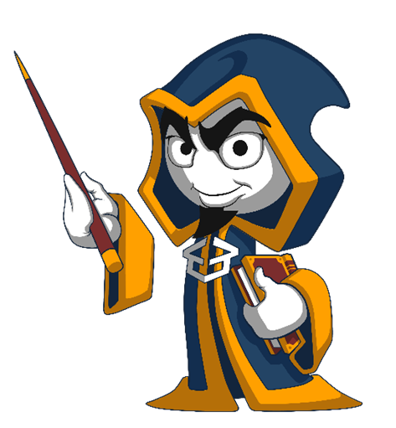
Summary
Arrow functions ≈ short function syntax
Event Loop
Event Types
Event Object Properties and Methods
preventDefault();
stopPropagation();
Handling Events
Attach
Remove

Slide 63
Questions?
Notes:
63

Slide 64












SoftUni Diamond Partners

Slide 65




SoftUni Organizational Partners

Slide 66
Trainings @ Software University (SoftUni)
Software University – High-Quality Education, Profession and Job for Software Developers
softuni.bg, softuni.org
Software University Foundation
softuni.foundation
Software University @ Facebook
facebook.com/SoftwareUniversity
Software University Forums
forum.softuni.bg
Notes:
66

Slide 67

License
This course (slides, examples, demos, exercises, homework, documents, videos and other assets) is copyrighted content
Unauthorized copy, reproduction or use is illegal
© SoftUni – https://softuni.org
© Software University – https://softuni.bg
Notes:
67

